Slide 1
SA1 Waterfront Event
13 February 2020

Slide 2
What is 5G?

Slide 3
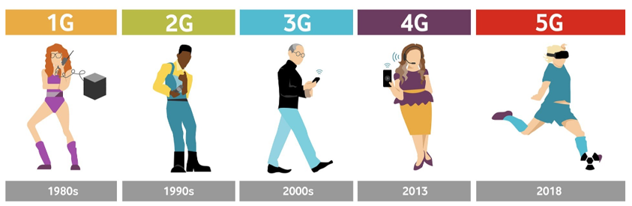
5G | Through the Generations………..our mobile journey
UK’s first mobile phone call made by Vodafone
Analogue only network
Voice only
Low battery life
UK’s first text message sent by Vodafone (1992)
Picture messages introduced
Could handle only small amounts of data
3G launches, enabling video calling and streaming (2004)
First mobile broadband offered
Consumers start to sue their phones more for mobile internet and streaming
4G goes lice in UK (2013)
Mobile Broadband Internet dongles become available for laptops/tablets
New applications such as gaming services, HD mobile TV, video conferencing and cloud computing offered on the go
Vodafone completes live 5G test with UK’s first holographic call (20 Sept)
5G launched 3rd July 2019
Full 5G network anticipated for 2020 with even faster speeds and super low latency
Significant increase of data transfer and IoT connections
Simplifying of smart homes and seamlessly connected devices
Increased smart capabilities such as remote surgery
Notes:
When we describe mobile communications, we refer to the overall technology, speed, frequency and system in numeric generations such as 2G, 3G, 4G or 5G. Each generation have unique technologies that define them.
1G
The very first generation of commercial cellular network was introduced in the late 70’s with fully implemented standards being established throughout the 80’s. The radio signals used by 1G are analogue, meaning the voice of a call is modulated to a higher frequency rather than being encoded to digital signals.
2G
The second generation saw the introduction of GSM (Global System for Mobile Communication) technologies as a standard in the early 90’s. It allowed for digital voice and data to be sent across the network and allowed users to roam for the first time.
The advance in technology from 1G to 2G introduced many of the fundamental services that we still use today.
2.5G
Between the year 2000 and 2003, an upgrade in technologies introduced the packet network which provided high speed data transfer and internet and became known as 2.5G.
The standards included GPRS (General Packet Radio Service) and EDGE (enhanced Data Rates in GSM).
GPRS supports flexible data transmission rates and provides continuous connection with the network. It also allows for the service provider to charge for the amount of data that is sent rather than their connection time.
3G
Introduced commercially in 2001, the goals set out for third generation mobile communication were to facilitate greater voice and data capacity, support a wider range of applications, and increase data transmission at a lower cost.
For the first time, this generation supported high speed wide band internet access and allowed for video calls.
Significantly greater security features were introduced within 3G, including Network Access and Domain Security and Application Security.
4G
Initiated in 2010, the fourth generation is an all IP based network system. Its purpose is to provide high speed, high quality and high capacity to users while improving security and lower the cost of voice and data services, multimedia and internet over IP.
The major benefit of an IP based network is that it is able to seamlessly handover, for voice and data to GSM, UMTS and CDMA2000 technologies from the previous different generations infrastructure.
4G introduced the LTE standard which only support packet switching and an all IP Network. There are a significant amount of infrastructure changes needed to be implemented by service providers in order to supply because voice calls in GSM, UMTS and CDMA2000 are circuit switched, so with the adoption of LTE, carriers will have to re-engineer their voice call network.
5G
5G is the next generation of commercial cellular network, set to greatly increase internet connectivity speeds. At this time, there aren’t any publicly agreed definitive standards that have been set as with previous generations so not a great deal of information is known about the specific technologies that are going to be used.
Different estimations have been made for the date of commercial introduction of 5G networks, but they are generally around the year 2019.
One of the main benefits of increased connectivity being plugged as the underlying selling point of 5G is IoT (Internet of Things), which would make the most of the higher speed of connectivity to allow for seamless integration of devices on a scale never been achievable before.

Slide 4




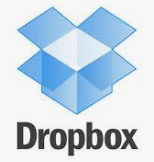





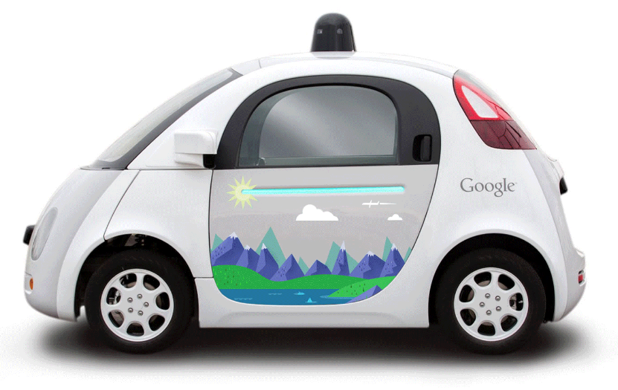





5G | Key market trends driving the need for 5G
Data Traffic Growth
New services
More devices
Digitalisation
1% growth per week
New tariffs &propositions
Developing use cases
Always connected
4k
Notes:
Today Vodafone 98% of the UK population has 4G. 4G is truly transformative technology. We recently got 450Mpbs out of our London network. And there are more improvements to come.
This transformation has been delivered by our largest ever UK investment programme. Over £2bn invested. And we continue to invest.
It is important to remind ourselves of this journey because 5G will be built on the foundations laid with 4G, including the physical network. We will face the same challenges we face today with 4G in terms of barriers to investment and roll out of the network needed to exploit 5G to the full.
5G is an evolution of 4G. It will build on the digital network management techniques we have been developing on 4G like network virtualisation and network splicing. It will enable us to manage the network more effectively and more efficiently.

Slide 5
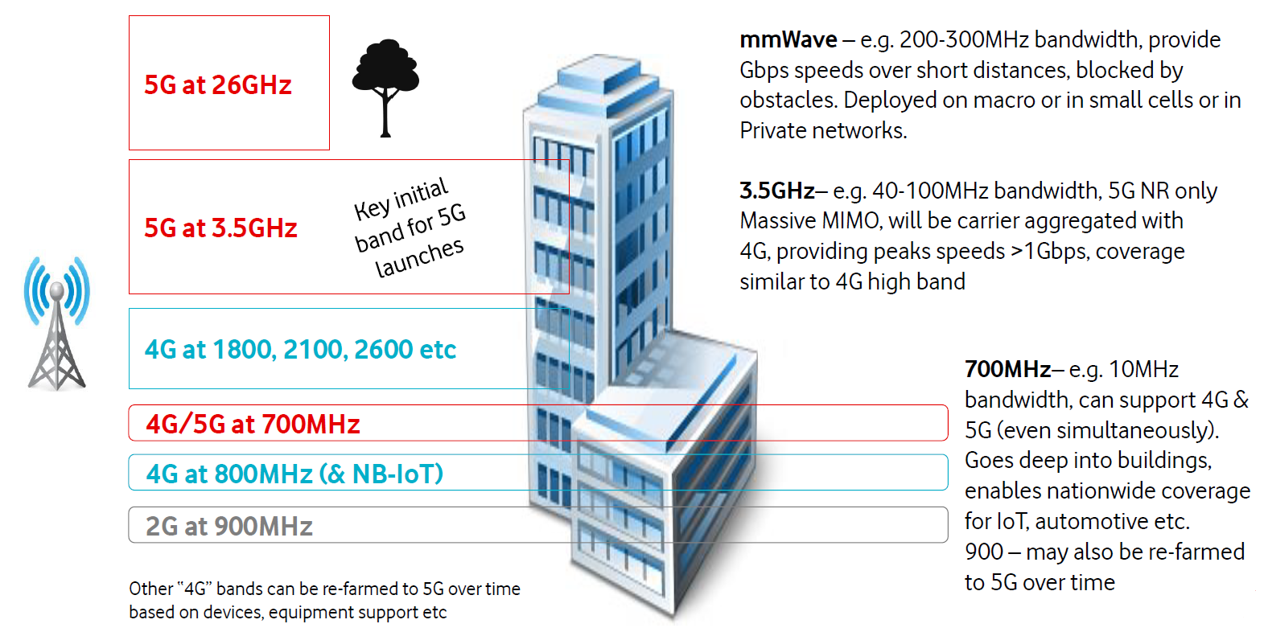
5G radio will start in high & low bands initially with 3.5GHz as the key band

Slide 6
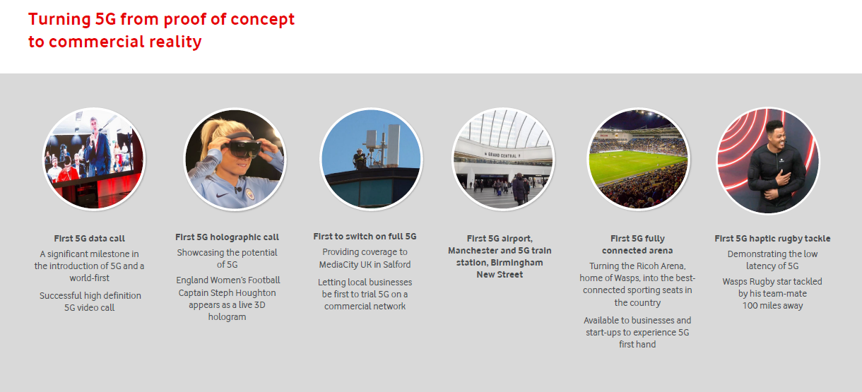

Slide 7
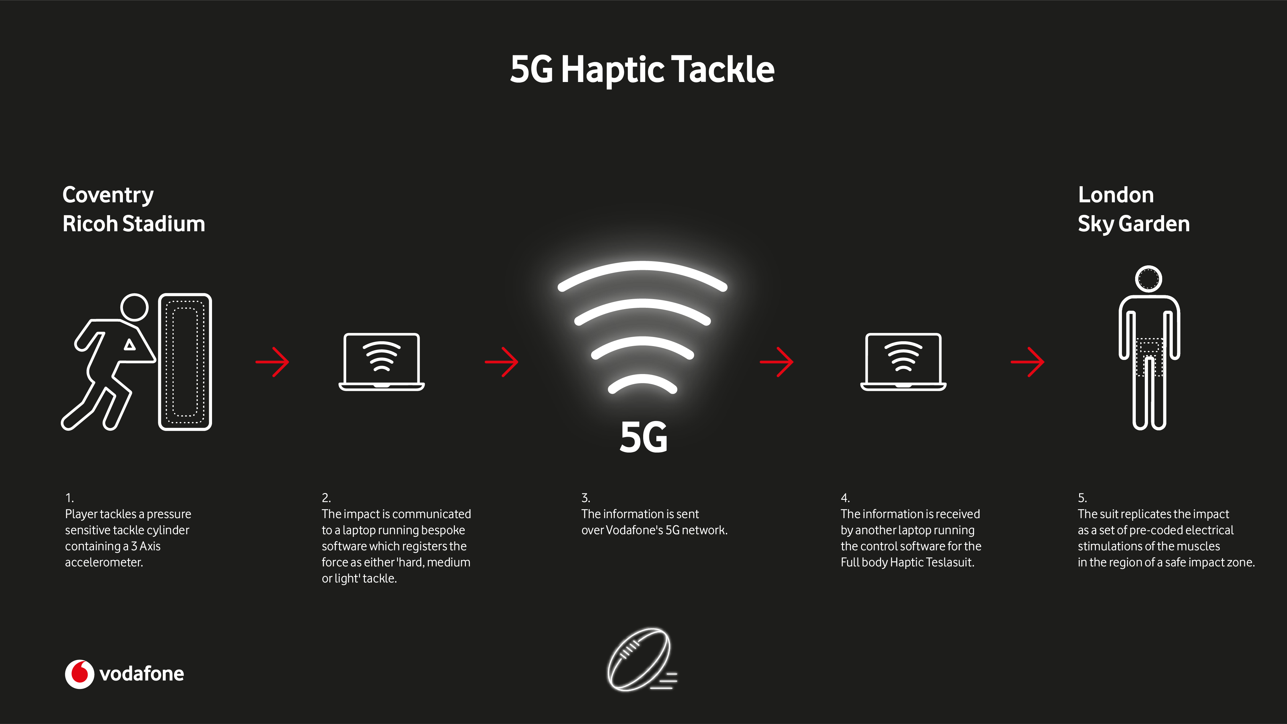

Slide 8
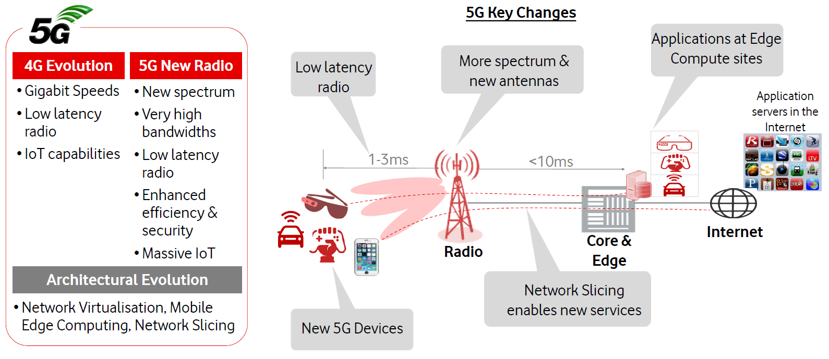
5G encompasses ‘4G Evolution” and new 5G Radio supported by common architectural evolution
Notes:
Radio upgraded to reduce latency by ~10ms (on both 4G Evo and 5G)
New 5G spectrum deployed, massive MIMO antennas added to site to increase speed & capacity
Applications moved into the network to further reduce latency by many 10’s of ms (Mobile Edge Computing)
Network slices to enable new services and opportunities (e.g. a slice for “low latency” or “connected cars”)
New devices supporting 4G Evo and 5G

Slide 9

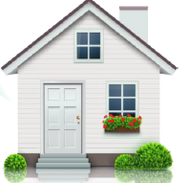















5G | The Opportunities
Speed & latency enable new applications…
ULL: Ultra Low Latency
ELL: Enhanced Low Latency
LL: Low Latency
LL
ELL
ULL
Network Speed
FWA
Remote Telemedicine
100 Mbps
Cloud Robotics
Drone Surveillance
4K/8K Video
Streaming
V2X
Immersive
AR/VR
Cloud Gaming
10 Mbps
AR on the Go
Smart Factory
Basic
AR.VR
AR Gaming
Meters & Sensors
Video
Streaming
Multiplayer Gaming
1 Mbps
Smart Grid
Network Latency
100 ms
50 ms
1 ms

Slide 10






5G | Can it enable more than better speeds and latency in society?
Autonomous Vehicles
Vehicle expected to perform all safety critical driving functions and monitor roadway conditions
Smart Cities
Traffic management, lights, road signs, sensors to detect and control vehicles, congestion
eHealth
Robotic & remote surgery, remote diagnosis and medical services, assisted living, Home medical IoT
Drones
Consumer and commercial purposes (Agriculture, law enforcement, land mapping, inspection, emergencies)
Video Surveillance
UHD CCTV data usage for Enterprise security monitoring systems
Connected Factories
Collaborative robots, sensors, process optimisation, remote maintenance, asset tracking

Slide 11
Thank You

