Slide 1
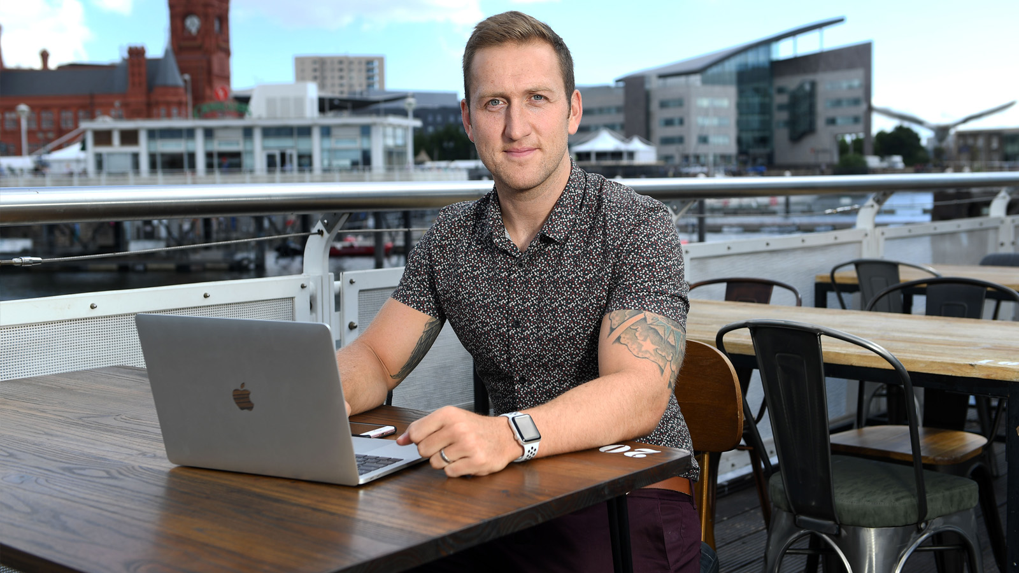
Supporting business success with digital

Slide 2
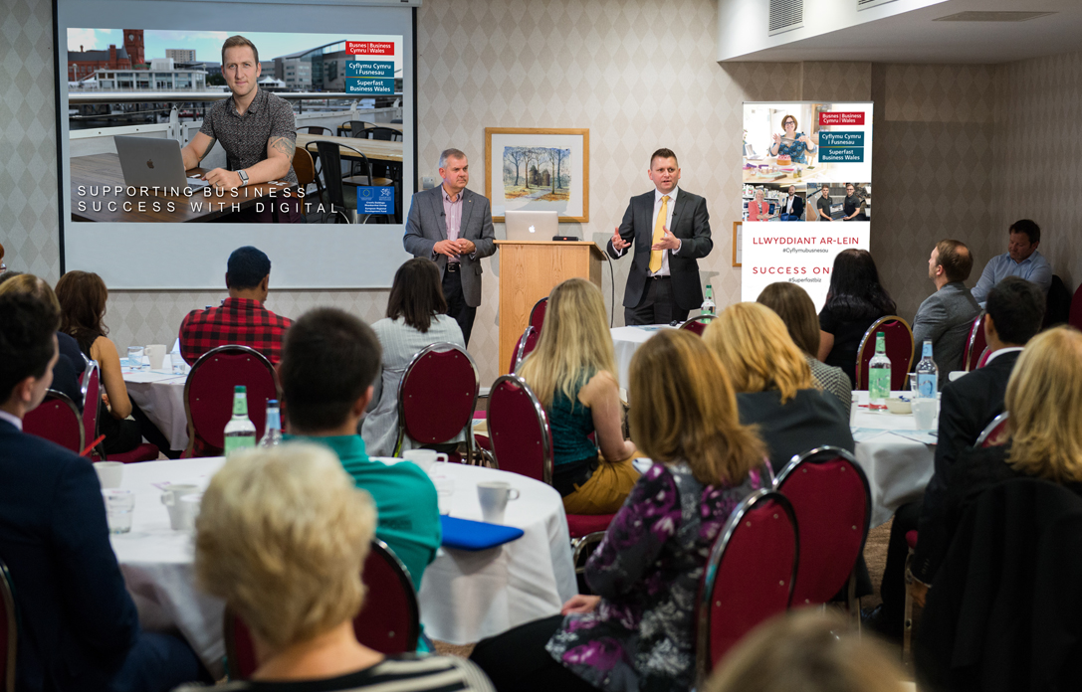
Free digital support for business
1
Register now at:
businesswales.gov.wales/superfastbusinesswales to find out if you are eligible for our services
2
Book a 4-hour practical workshop at: businesswales.gov.wales/superfastbusinesswales/events on how to win business, improve processes and save time and money with digital
3
Enjoy tailored 1:1 support to develop an action plan that meets your needs
4
Receive a website review to discover how to maximise you online presence
5
Access FREE online resources: Software Directory • Learning Modules • Guides • Tips & Blogs

Slide 3
Main benefits of SFBW tailored support
Reduce costs
Save time
Grow profits
Improve stability
Invest now for
long-term savings
Streamline internal processes
Attract and retain customers
Boost staff skills
and work processes

Slide 4
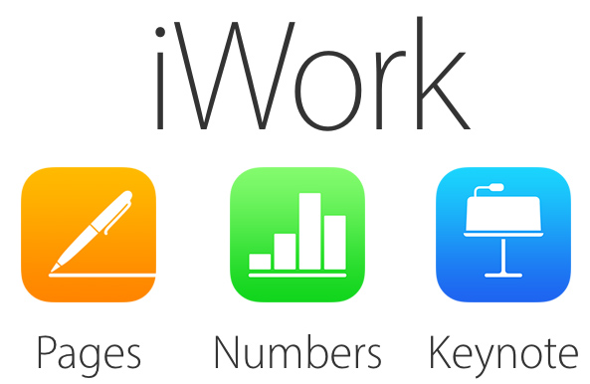
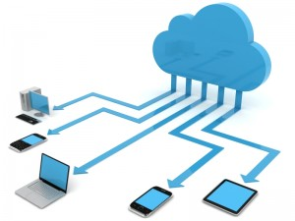
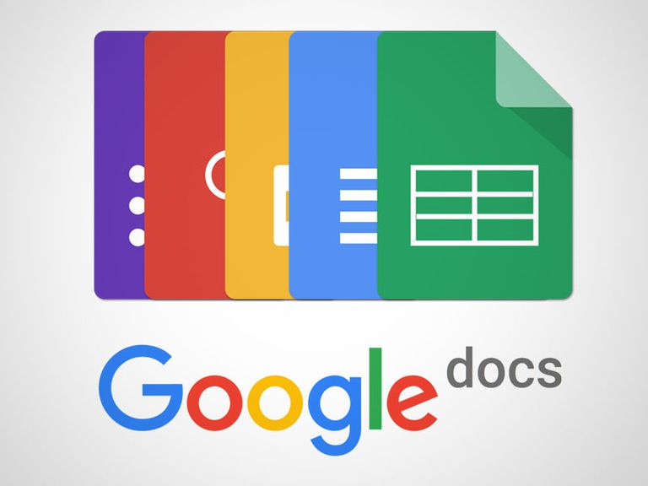
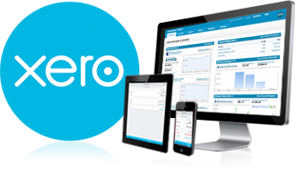
Saving time and money with the cloud

Slide 5
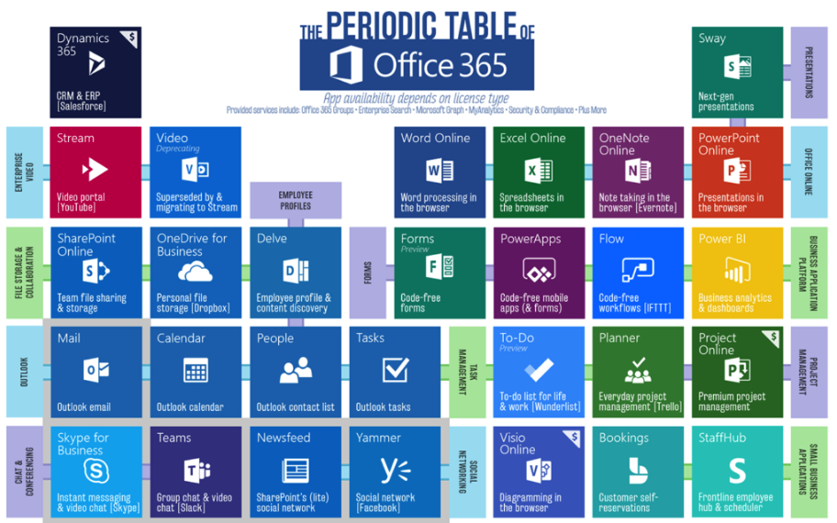
what is office 365?
But also includes…
Outlook Customer Manager
MileIQ
Bookings
Invoicing
Yammer
Microsoft Forms
Power BI
Flow
Teams
Publisher
SharePoint
Access
OneNote
One Drive
Skype
Teams
And…
Projects
Exchange
Dynamics
And more...

Slide 6
Building your brand with social media

Slide 7
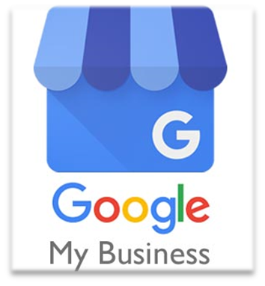
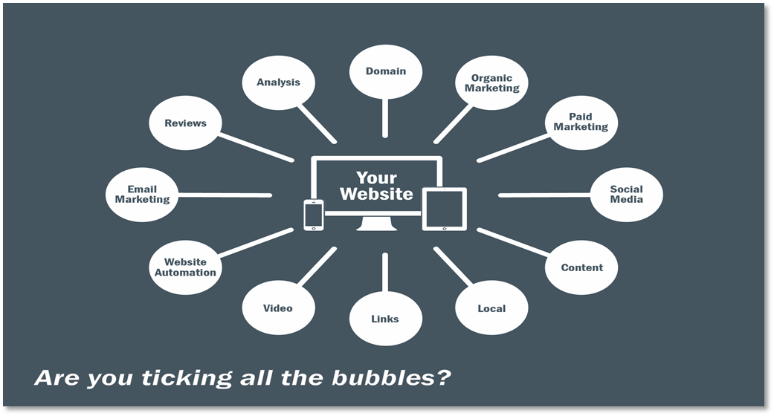
Promoting your business online

Slide 8
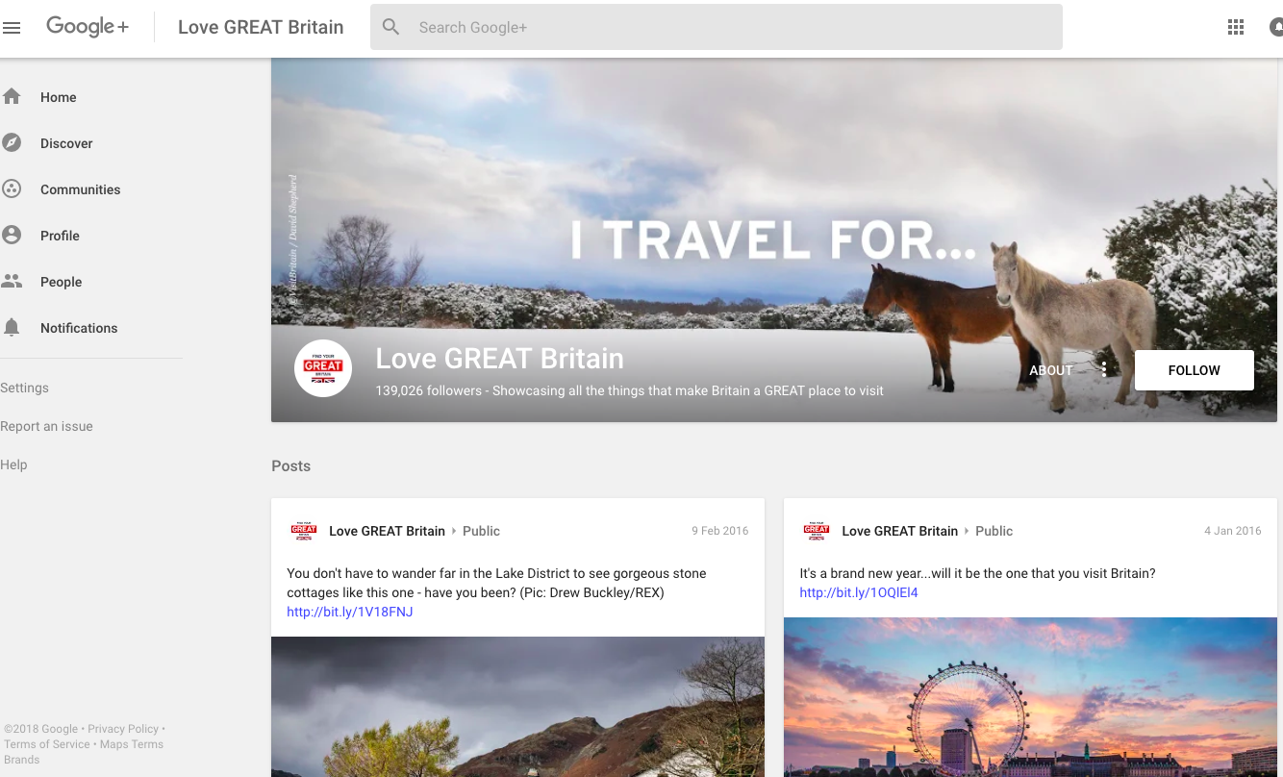
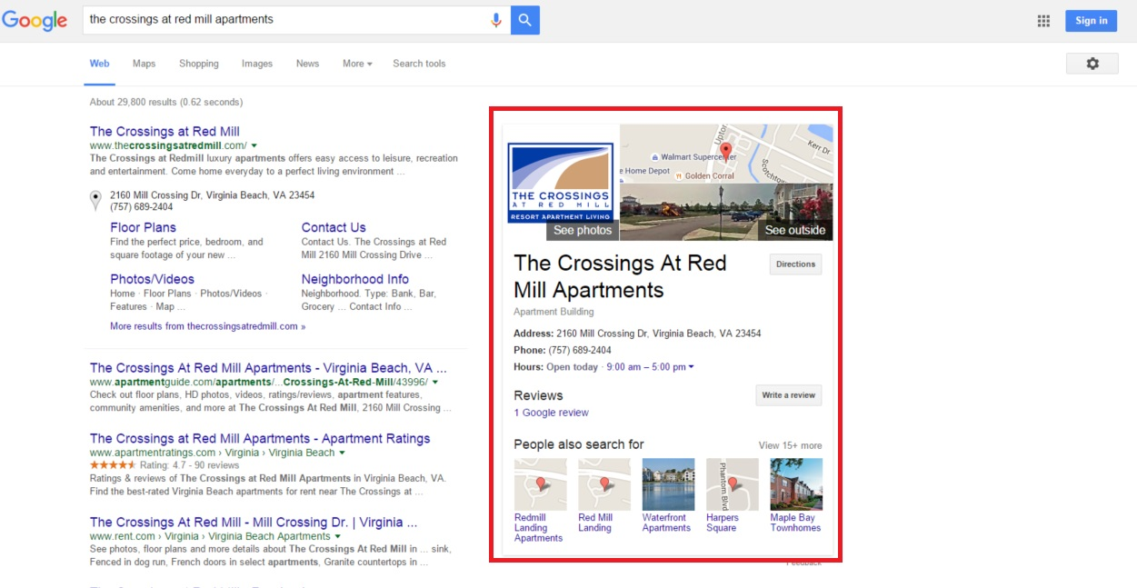
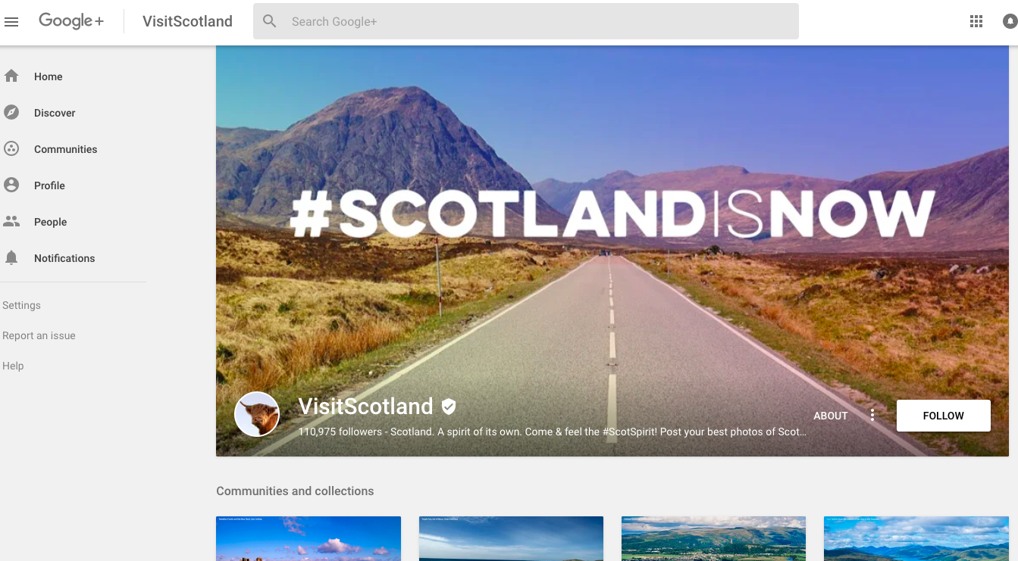
GooglE My Business
Notes:
Visit Wales and many others do not have a Google + presence any longer
Draw the group’s attention to the theme of the boards used by Visit Britain and Visit Scotland. Note the high quality photographs again and the hashtag #FindYourEpic
People can follow your posts.
Highlight the About, Posts, Photos and Videos sections.
Emphasise Google My Business

Slide 9
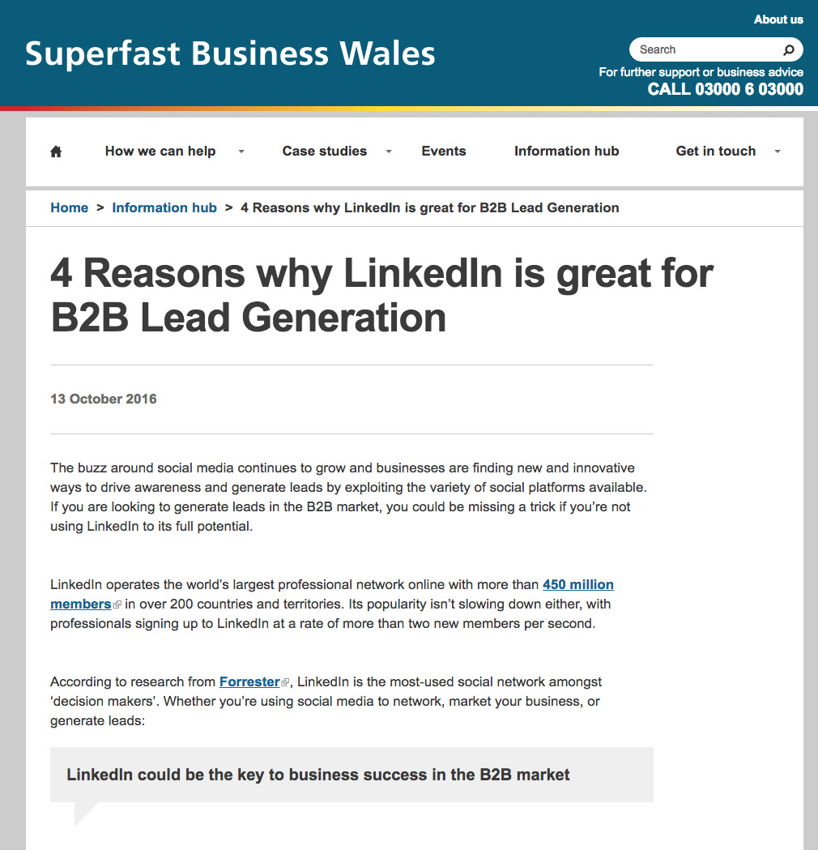
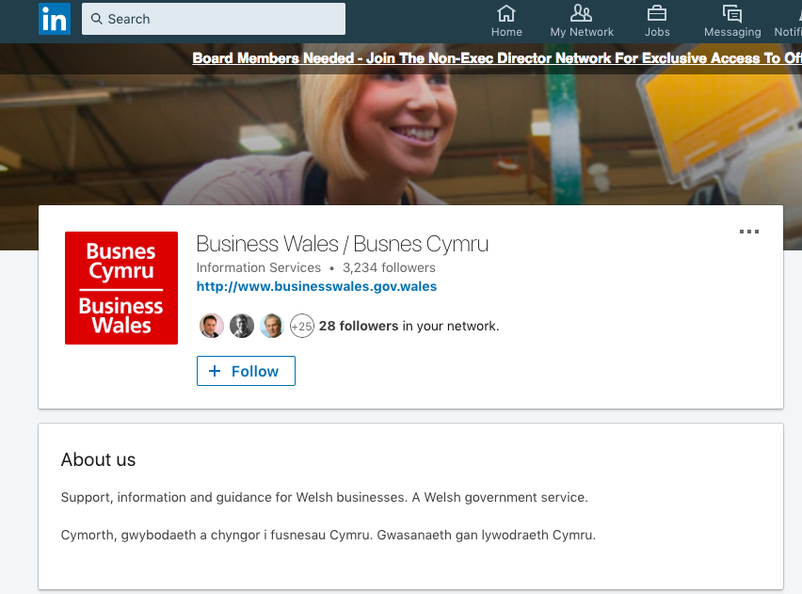
LinkedIn
Notes:
NB: Stress company presence and individual presence – connect both. LinkedIn has great new resources for smaller businesses – check out their help feature
ACTIVITY
Ask who has a LinkedIn profile set up. Ask if one of them would be happy to show their profile on screen. You will need a web browser ready to open for this.
Facilitate a short discussion on how they set it up, why they did and for what they use it now. Repeat this with another member of the group.
There’s a very good chance that at least 1 person in the group will have a LinkedIn profile. If not, be ready to show either your own profile and to share why you’ve set it up or show someone else’s you know.
LinkedIn is particularly opportune for owners/staff who have a key skill to offer, especially if you operate in the service industry and B2B.

Slide 10
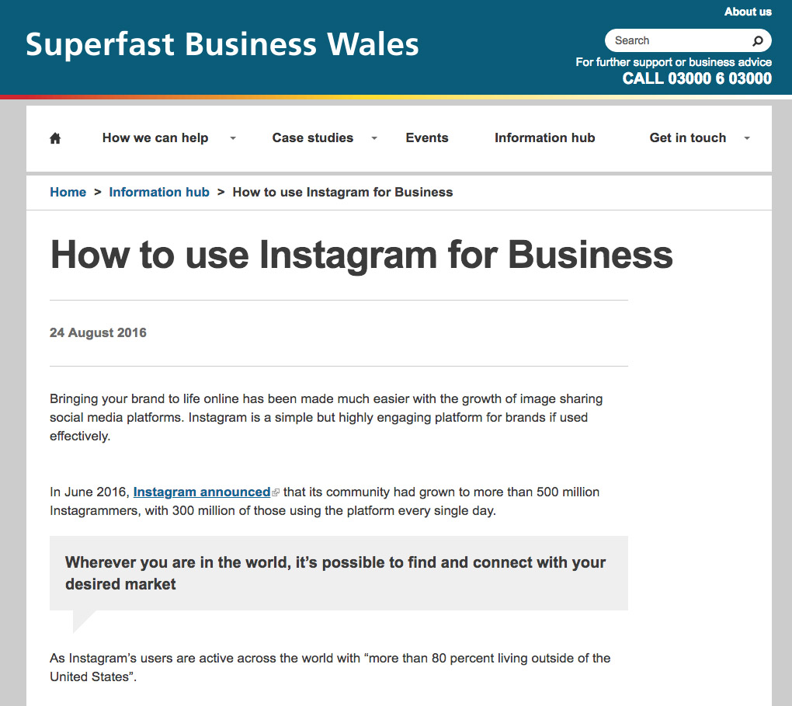
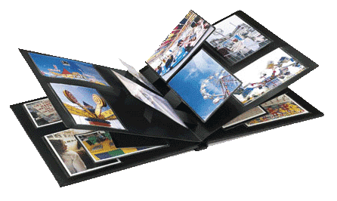
Instagram
“Your business’ photo album”
Notes:
Huge growth on Instagram – passed 1 billion user mark in June 2018 (owned by Facebook)
Present Instagram as a photo album for their business. Probably one the most visually attractive platforms.
Misconception that the site is best suited for fashion/trend sensitive industries, creative businesses and food companies. There are plenty of examples of what could be considered as “boring” companies using Instagram effectively to build up brand awareness and customer loyalty.

Slide 11
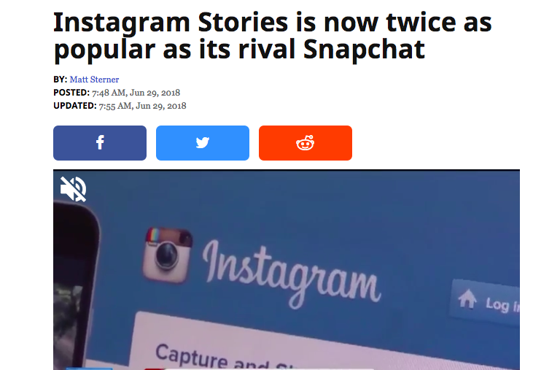
Instagram – It now has more users
than Twitter, Snapchat and
Pinterest combined
Facebook 2.2. billion
Instagram 1 billion
Twitter 340 million
Pinterest 250 million
Snapchat 190 million
Notes:
Instagram is fastest growing platform and is a tourism and hospitality starting to use it prolifically.

Slide 12
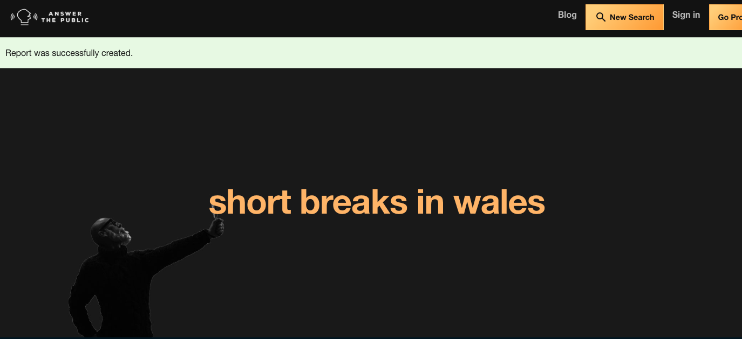
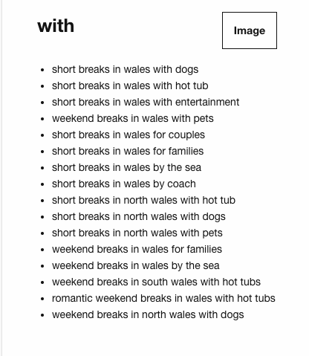
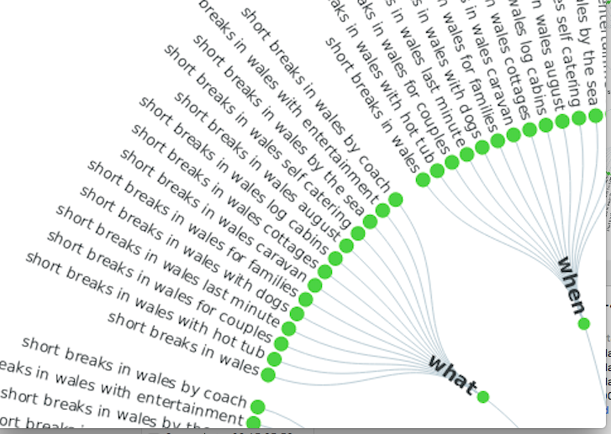
Answerthepublic.com
Notes:
www.answerthepublic.com
Searches in real time to tell you what search terms are currently popular – put in a phrase or key word and it will generate reports that will help you with establishing ideas for blogs, web content, social posts etc.

Slide 13
Targeting options on Facebook…
Location
Age
Generation
Gender
Language
Education level
Field of study
School
Ethnic affinity
Income and net worth
Home ownership and type
Home value
Property size
Square footage of home
Year home was built
Household composition
Users who have anniversaries within 30 days
Users who are away from family/hometown
Users who are friends with someone who has an anniversary/ newly engaged/married, etc.
Users in long-distance relationships
Users in new relationships
Parents
Expectant parents
Mothers divided by type – e.g. trendy, football, etc.
Politics
Relationship status
Industry
Jobs
Car owners – types, insurance renewals, etc.
Device use – e.g. mobile, tablet, pc, etc.
Interests
Donators to charity
...AND another 50 more!
Notes:
This might shock some people – think about what people share and talk about on Facebook and you’ll realise how they can – it tracks your usage, on all devices, your location etc. It also works with companies like Epsilon to gather info from govt records, insurance policies, surveys, commercial sources like magazine subscriptions
This is from the Targeted Ad Education section on Facebook – it’s updated their ad preference settings

Slide 14
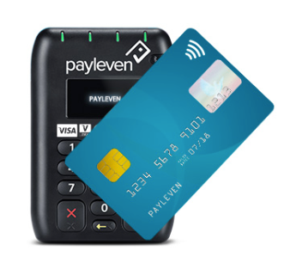
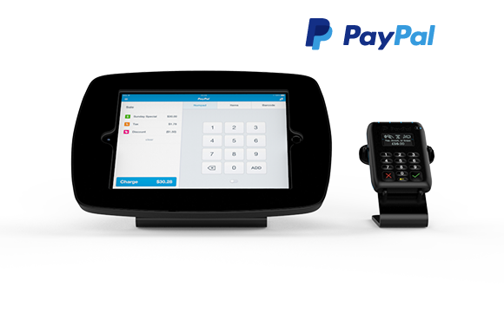
Getting paid
iZettle / PayPal Here and Bouncepad / Payleven
Notes:
Work using mobile telephone signal, can be cheaper than traditional PDQ – add indicative costs?
Portable
Can be used at client’s premises
izettle -Smart Rate automatically reduces your transaction fees based on your monthly sales - starting at 2.75% and dropping to as little as 1.50% per transaction. go to their website to see an interactive guide.
Paypal here - initial fee for the software £59 - then pay from 2.75% to 1.9% +20p transaction fee on contactless and chip and pin - higher % if swiping magnetic strip.
Be aware of charges - made clear on their websites.

Slide 15
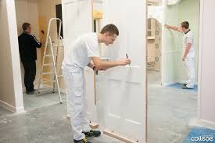
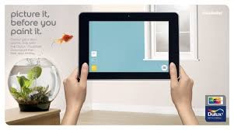
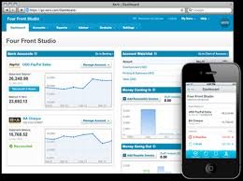
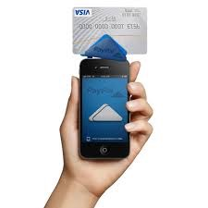
Case Study: Painter & Decorator
Notes:
Dulux Visualizer – Customer chooses colour
Skitch – for making notes
Xero Me – timesheets
Xero – Invoicing
Paypal Here – Customer Pays

Slide 16
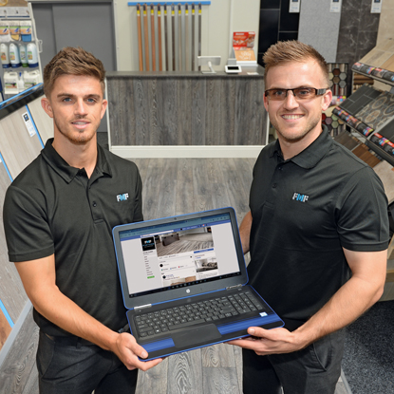
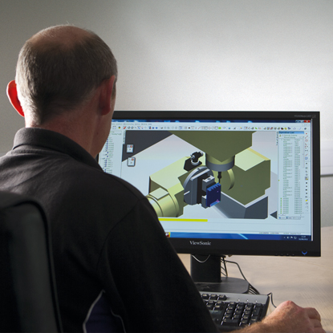
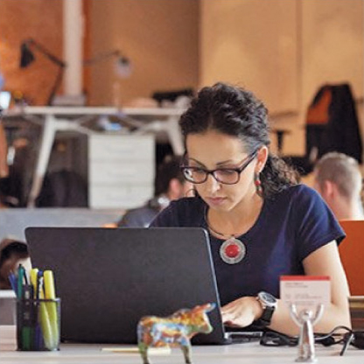
small changes make big differences
“
“
“
“
Remote working has saved us £3,600.
D&G Office Interiors
We’re driving 34% of our sales through Facebook.
Fit My Floor
“
“
“
“
Digital technology
helped increase
our revenue by 20%.
Tarvin Precision Engineering
We boosted revenue by 40% with cloud technology.
Nordic International
“
“
“
“
We made 300% efficiency savings
with digital technology.
GeoSmart Decisions
Switching to digital increased our productivity by 50%.
Enquin Environmental

Slide 17
Setting up camp on Facebook drives expansion for Wonderfully Wild
The owners of a luxury glamping site on Anglesey, who diversified from farming, have now added a Georgian holiday property to their portfolio in response to high customer demand from Facebook.
We settled on glamping and were very focused with our audience: families based across North Wales, Cheshire and Greater Manchester.
“That focus transferred to our marketing, and Facebook accounts for the majority of our promotional efforts. The beauty of Facebook advertising is you can target and narrow your market down, which means you can spend less and get a greater return on investment. Some of our best results have been from campaigns where we spent £1 per day for 90 days.
We changed our booking system to Super Control, which is very user-friendly and allows people to book directly online.”
Wonderfully wild

Slide 18
Digital Tax made Superfast and easy!
Developed a free app for small businesses moving onto HMRC’s Making Tax Digital service. Businesses use their phone to take a photo of their receipts, as well as record invoices and mileage in real time.
“Everything was paper based, all my client files and receipts. I was having to manually check and input up to 900 receipts a month just for one client. Moving everything online onto bespoke accountancy CRM designed for accountants. It’s literally saved me hundreds of hours a month. All of my clients’ details are there including conversations and their history, and it prompts me when I need to take action for a particular client.”
Switching to Office 365 has made working between his Monmouthshire 2 offices easier. A new website which integrates with QuickBooks and has an online document portal for clients.
Skype and VoIP means he can save on traditional phone line rental costs and make telephone and video conference calls without having to be based in the office.
“Digital helps me provide a much better service and frees capacity to work with more clients”
“I travel to see them, and technology means I can take the business with me. Going digital has given me more free time to spend with my family.
Choice bookkeeping

Slide 19
CELTEST GENERATES A CONCRETE 2000 HOURS EFFICIENCY SAVINGS A YEAR
Significant savings in telecoms costs through a VoIP phone system, improved efficiency each week by making savings using electronic reporting direct from test sites and increased the amount of business enquiries coming through its upgraded website. The company has also vastly improved cyber-security and is GDPR compliant.
Depending on the project, reporting now takes less than 24 hours, with some completed almost instantly.
There have been other cost and efficiency savings in areas like generating invoices – the new automated system saves around two hours a week
“The investment we’ve made in digital technology has already paid for itself “
Celtest

Slide 20
“Technology has transformed our relationships with staff and customers”
Cardiff-based cleaning company
By focusing on employee wellbeing and an improved customer experience, it’s grown sales by 200% and increased staff retention rates.
Works for the likes of Barclays Bank, Tesco and McDonalds.
Staff can book leave and manage rotas on their phones
Apollo also introduced a GPS-enabled system to track progress of its cleaning teams giving lone workers added security
Introducing automated billing has saved the business an average of two days per week, previously spent chasing outstanding payments.
Apollo now uses a Customer Relationship Management system called HubSpot as part of a proactive and targeted sales and marketing operation
Apollo wales

